Slide 1

Instagram Performance Analytics for Sugar Cosmetics
Tool:
TABLEAU
By
T. Kavitha Jayendran
GUVI Capstone Project 2026

Slide 2
Project & Dataset Overview
PROJECT
  Business Problem
  Dataset Overview
  Tools Used:
      Tableau
      EXCEL
  Project Objective
Dataset
Number of Records
Fields
Metrics
Dimensions

Slide 3
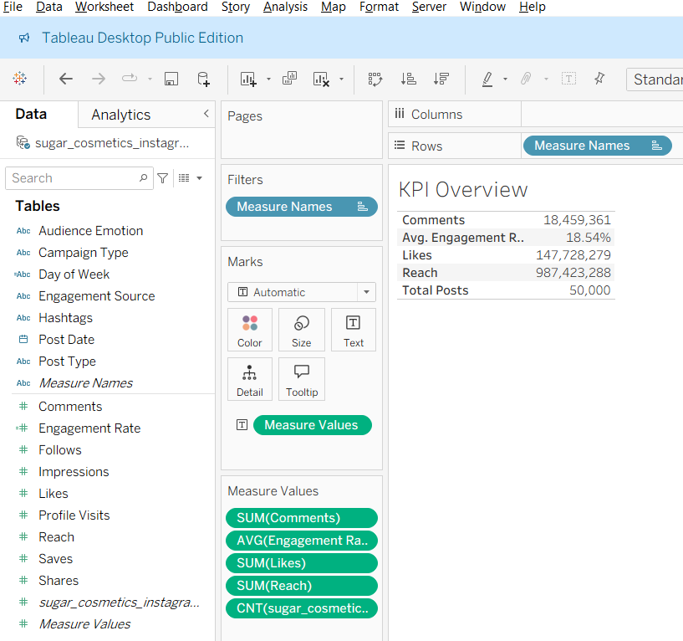
KPI Overview
Key Insights
  Analyzed 50,000 Instagram posts.
  Average Engagement Rate: 18.54%.
  Generated strong reach and impressions, indicating high brand visibility.

Slide 4
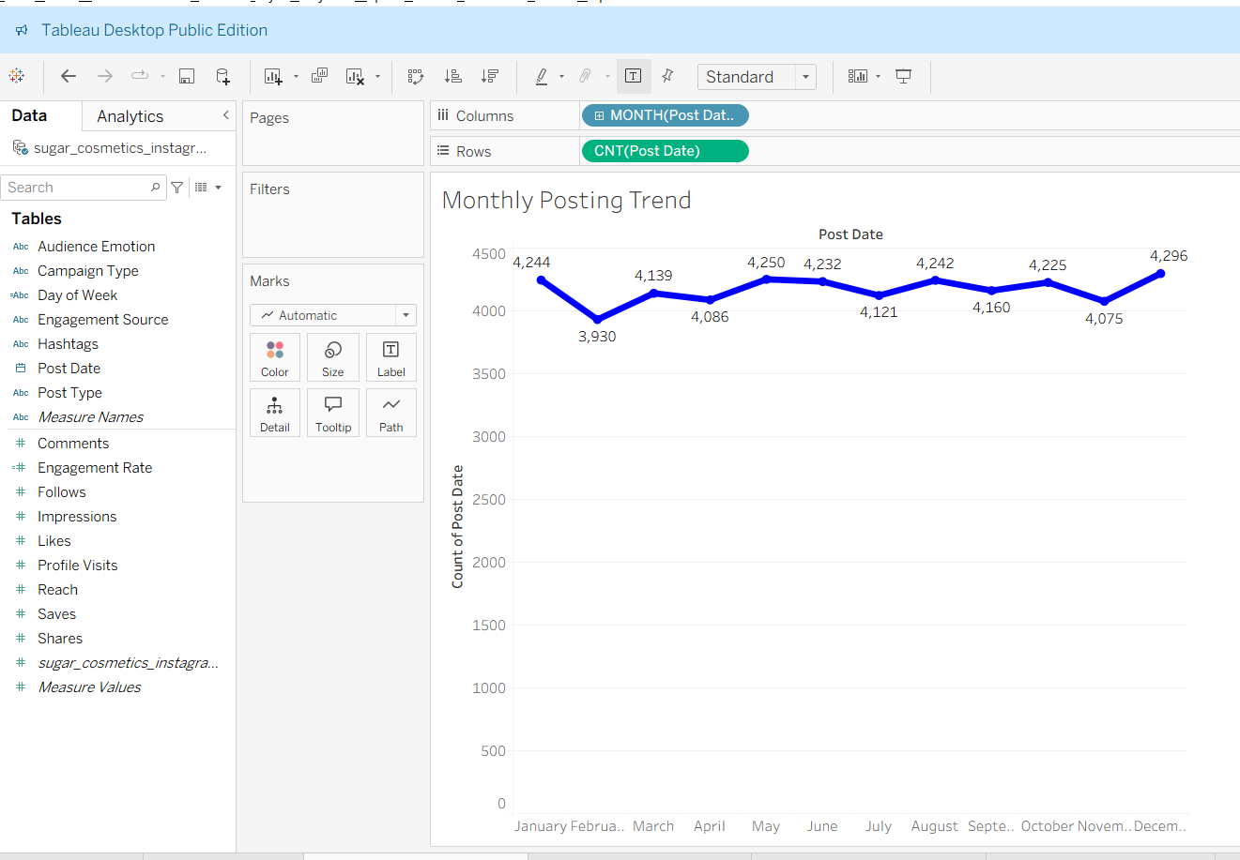
MONTHLY POSTING TREND
Key Insights
  Posting frequency remained consistent throughout the year.
  Minor fluctuations indicate a well-planned content calendar.
  Consistent posting helps maintain audience engagement.

Slide 5
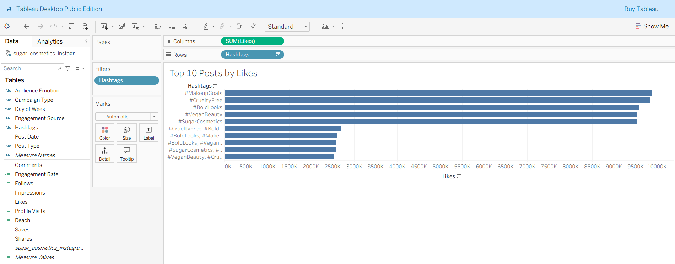
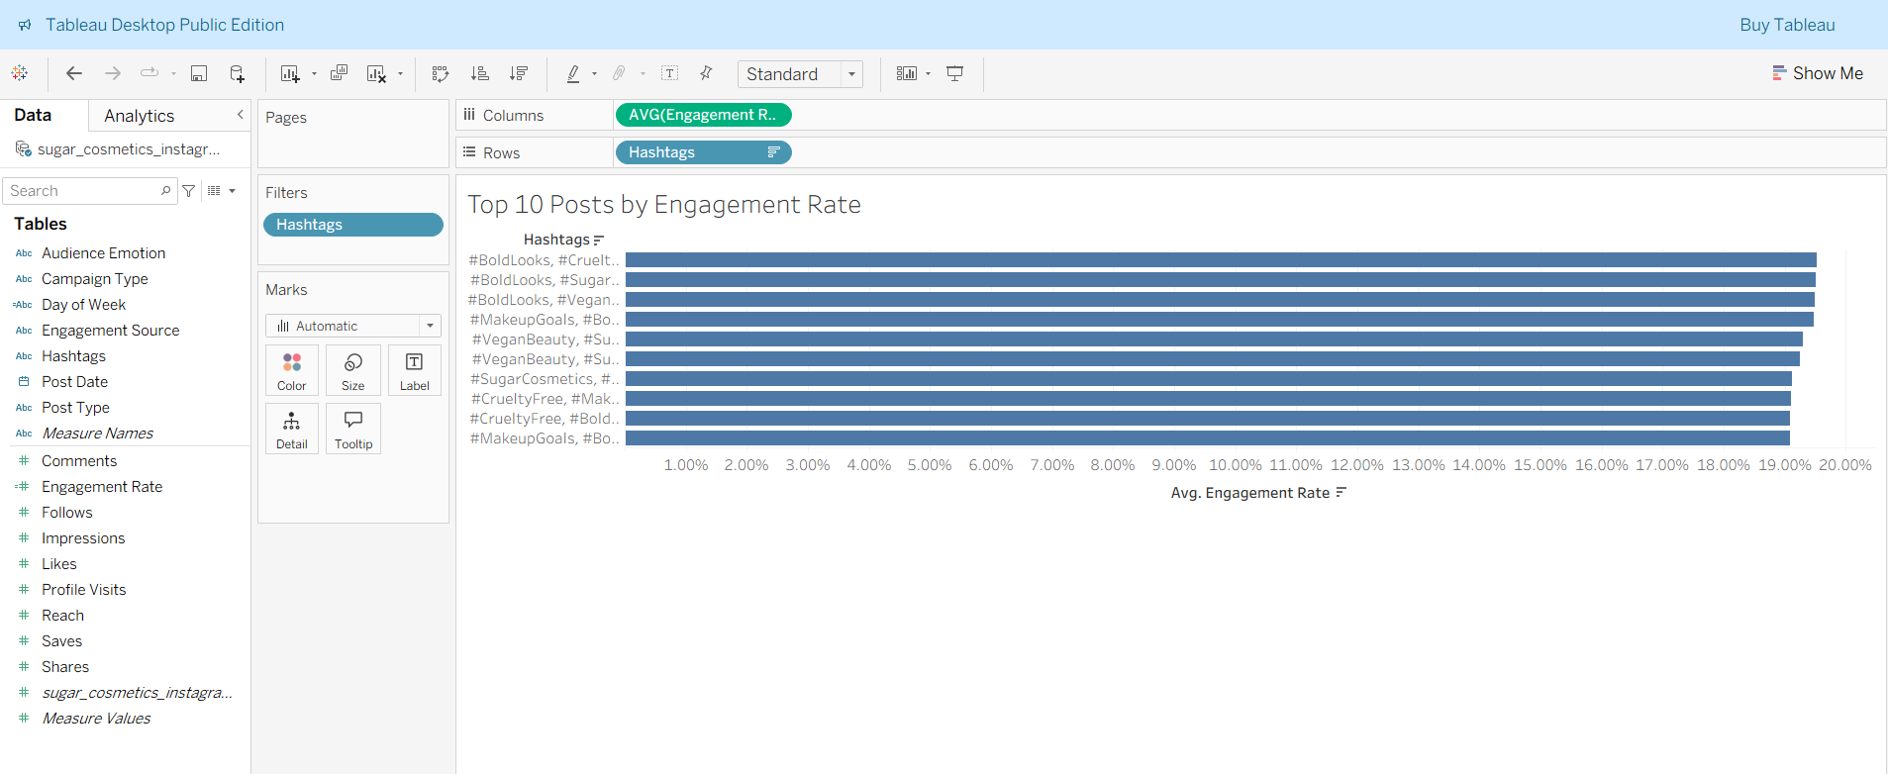
TOP PERFORMING POSTS
Key Insights
  Certain hashtag combinations consistently achieved higher engagement.
  High engagement is driven by quality content, not just reach.

Slide 6
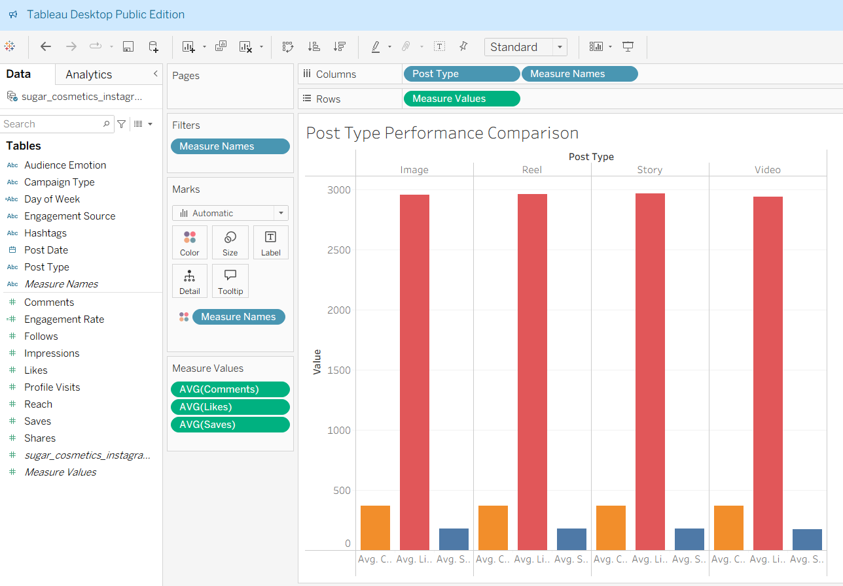
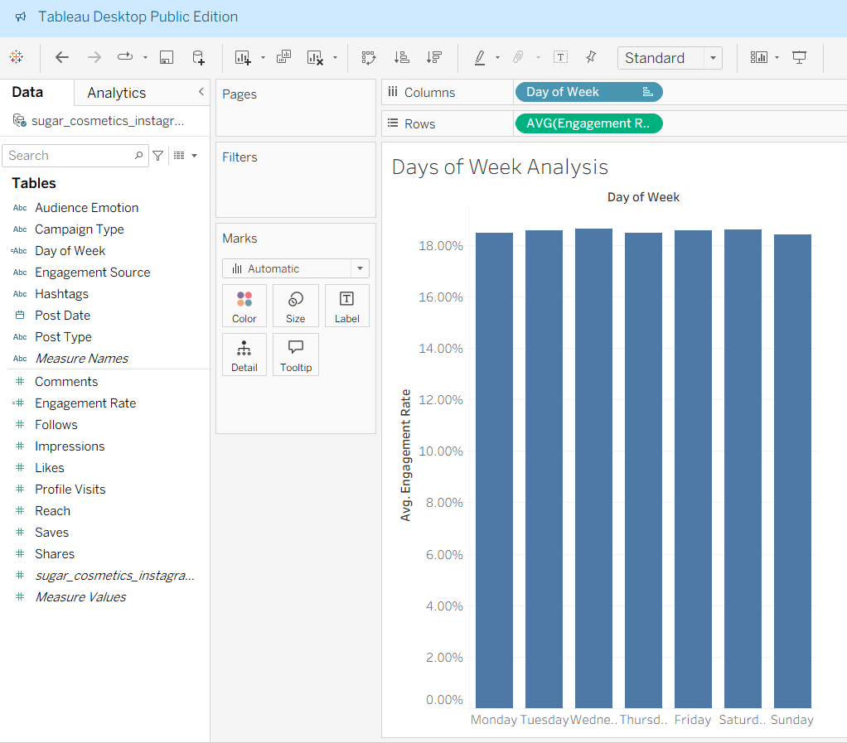
CONTENT PERFORMANCE
Key Insights
  Image and Reel content performed well across engagement metrics.
  Audience engagement remained relatively stable across weekdays.
  Content quality is more influential than posting day.

Slide 7
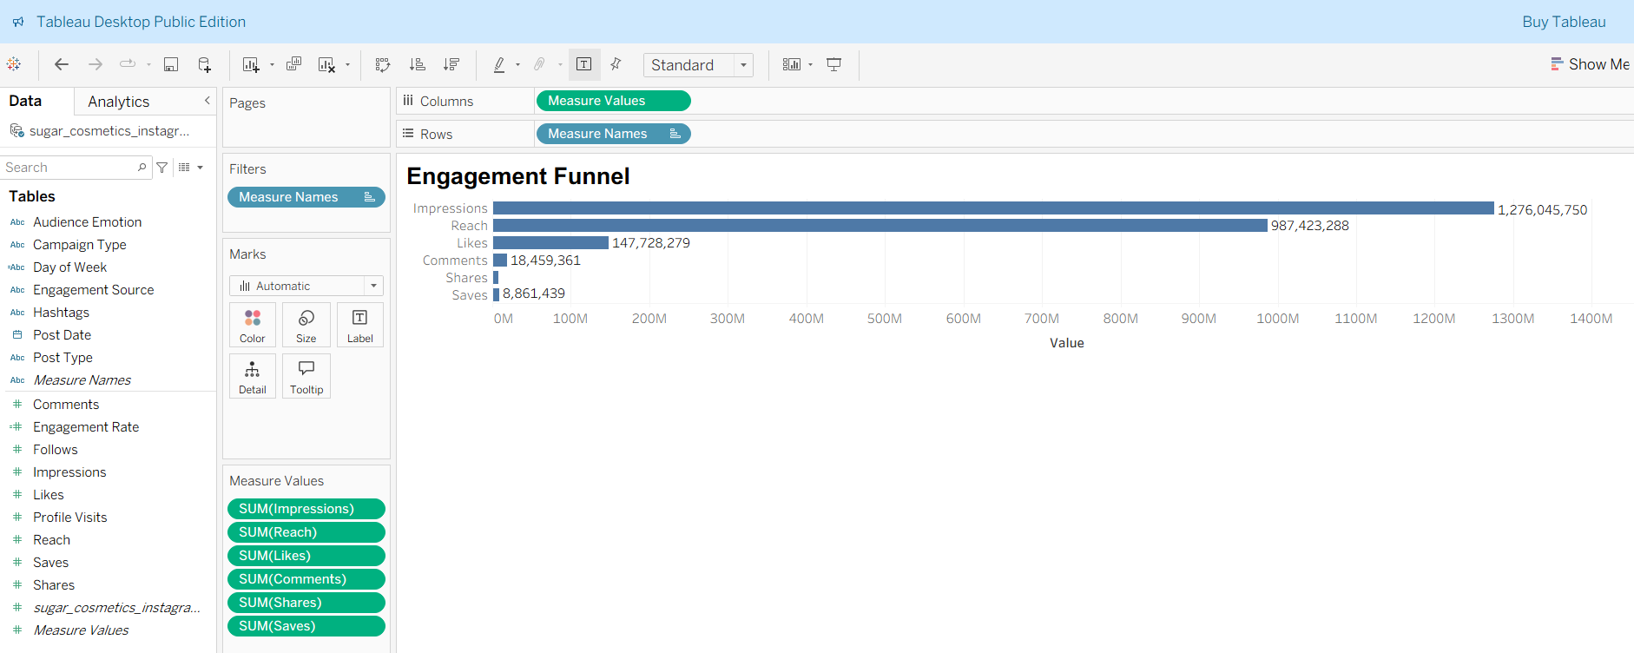
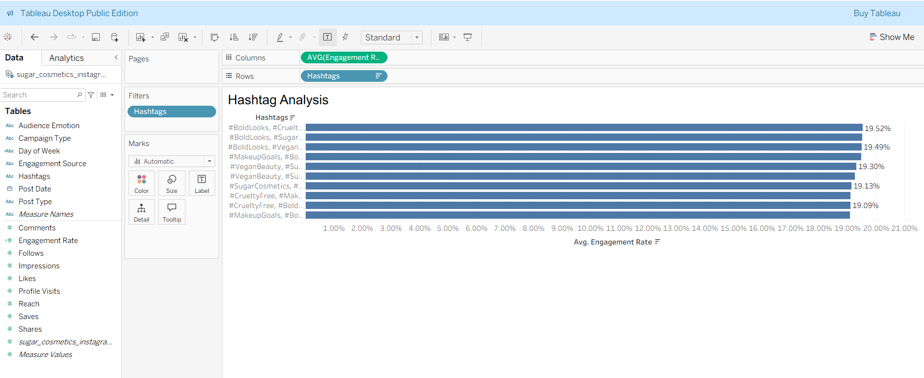
ENGAGEMENT ANALYSIS
Key Insights
  A noticeable drop occurs from Reach to Saves and Shares.
  High-performing hashtags improve discoverability and engagement.
  Stronger Calls-to-Action (CTAs) can encourage deeper audience interaction.

Slide 8
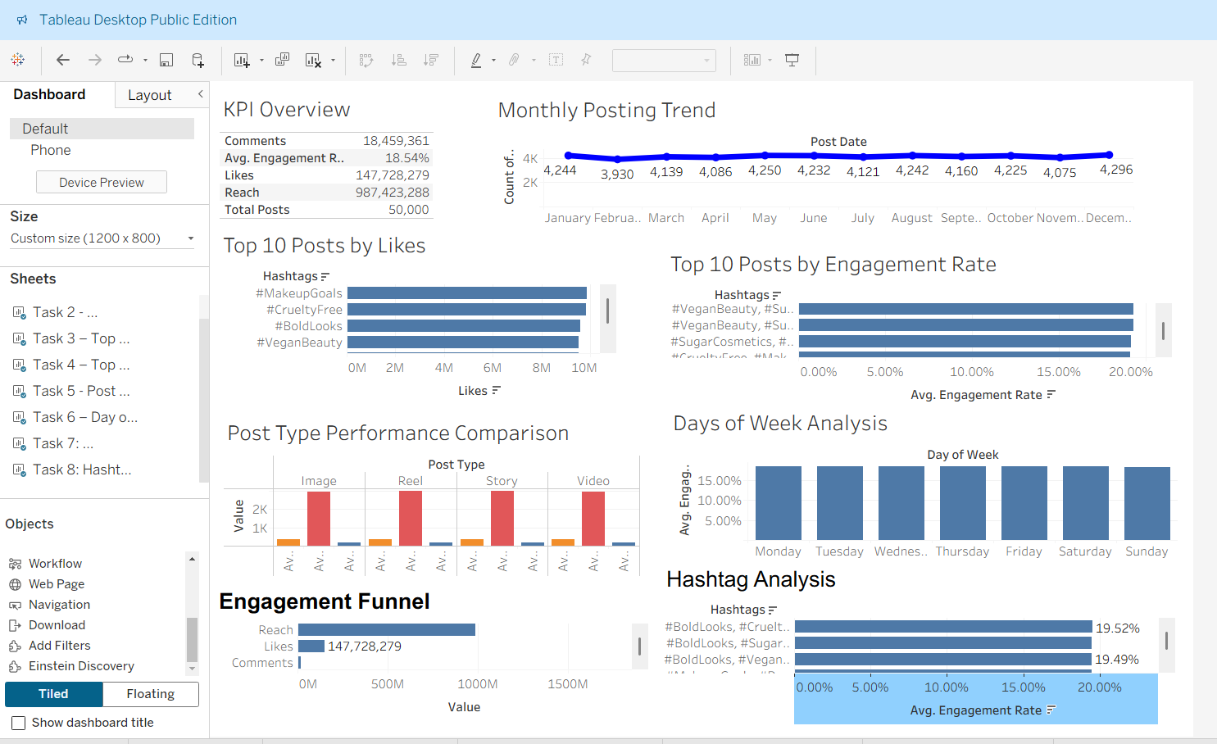
DASHBOARD
Business Value
  Interactive dashboard consolidates all Instagram performance metrics.
  Enables marketers to monitor KPIs and identify trends efficiently.
  Supports data-driven decision-making.

Slide 9

Strategic Recommendations
Recommended Strategies
  Increase the use of high-performing hashtags.
  Continue creating engaging Image and Reel content.
  Encourage Saves and Shares through stronger CTAs.
  Maintain a consistent posting schedule.
  Strengthen influencer and collaboration campaigns.
  Continuously monitor engagement metrics to optimize future campaigns.

Slide 10

CONCLUSION
Successfully analyzed Instagram performance using Tableau.
Developed interactive dashboards to evaluate engagement trends and content effectiveness.
Identified actionable insights to improve social media strategy.
Demonstrated how business intelligence tools support data-driven marketing decisions.

